Slide 1






BlockChain

Slide 2
What is Block Chain
A digital database
Data is distributed among al the node
It share information amongst all parties that access it.
Access to this ledger in terms of reading and writing may be unrestricted.

Slide 3
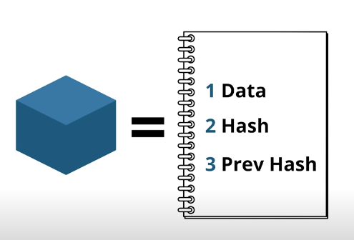
What is inside this block?
Data : relevant information.
Hash : unique code.
Previous Hash : unique code or hash of previous block.

Slide 4
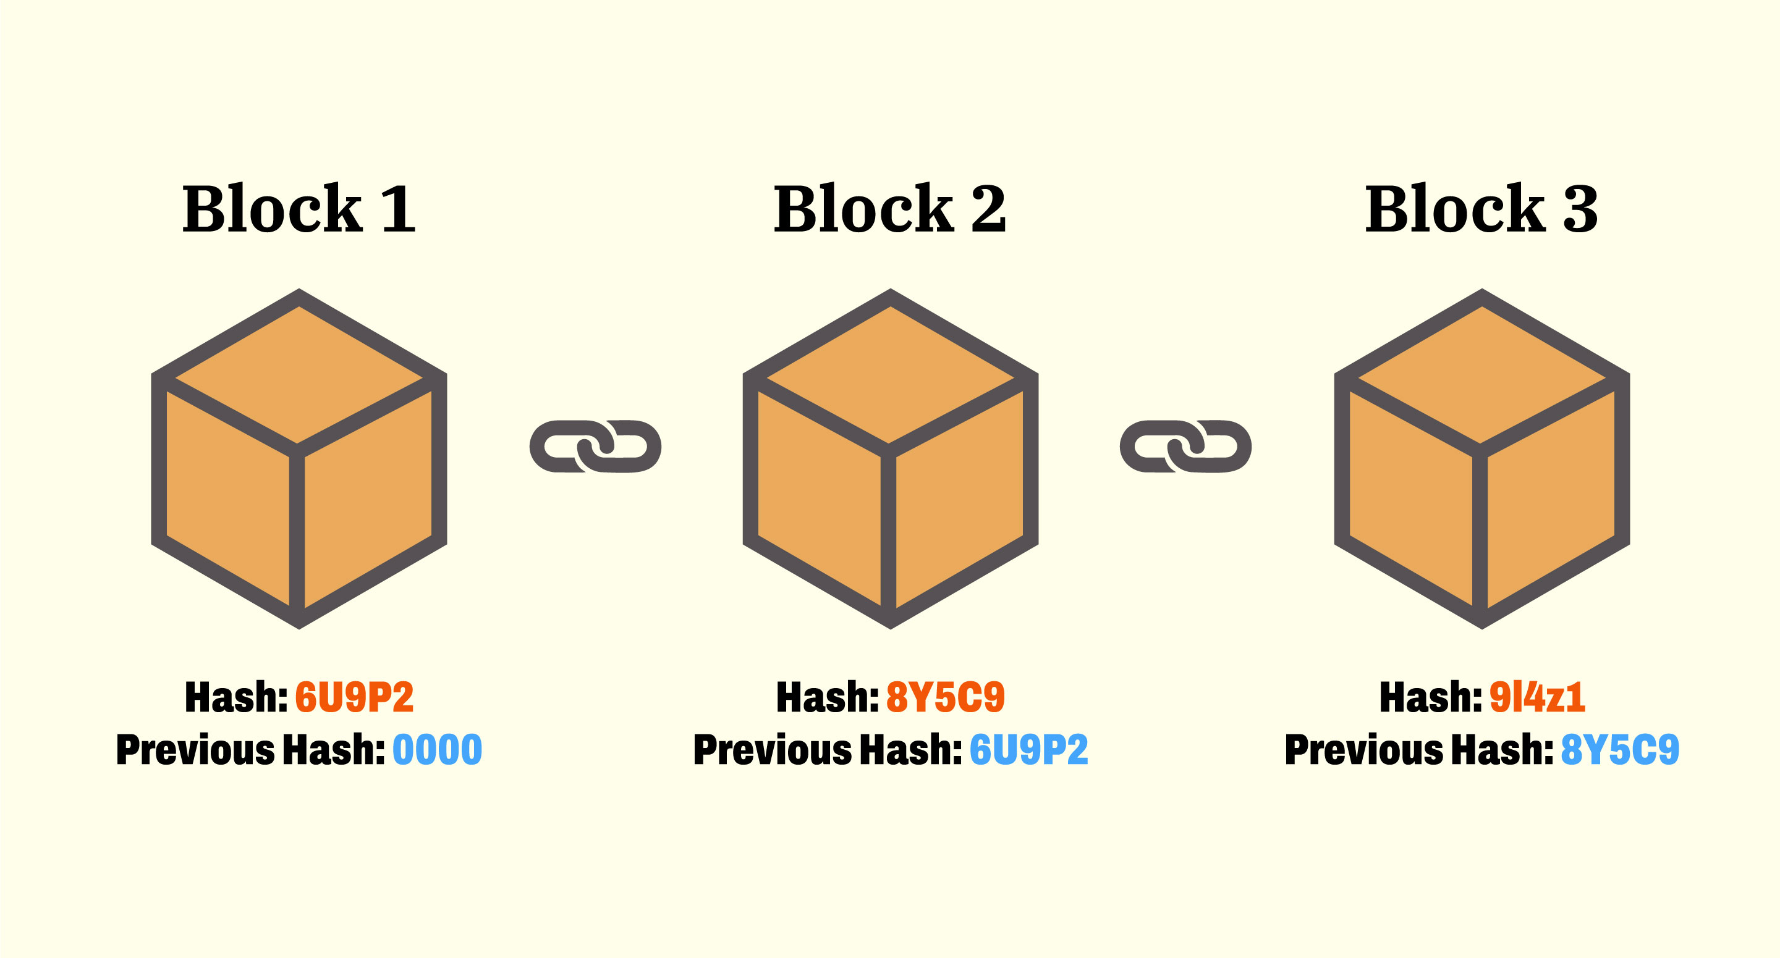

Slide 5
Difference between Blockchain VS normal Database
Blockchain
Decentralized data
There is no administrator in Blockchain.
Blockchain keeps the present information as well as the past information that has been stored before.
Database
Centralized Data
Database needs a Database admin or Database administrator to manage the stored data.
Centralized databases keep information that is up-to-date at a particular moment

Slide 6

Decentralized System
No one has to know or trust anyone else
Each member in the network has a copy of the exact same data in the form of a distributed ledger.
If a member's ledger is altered or corrupted in any way it will be rejected by the majority of the members in the network.

Slide 7
How it Works
A distributed database that maintains a continuously growing list of ordered records.
These blocks “are linked using cryptography.
Each block contains a cryptographic hash of the previous block and transaction data.
It is a decentralized, distributed and public digital ledger
It is used to record transactions across many computers
The record cannot be altered retroactively
The alteration of all subsequent blocks and the consensus of the network is must.

Slide 8
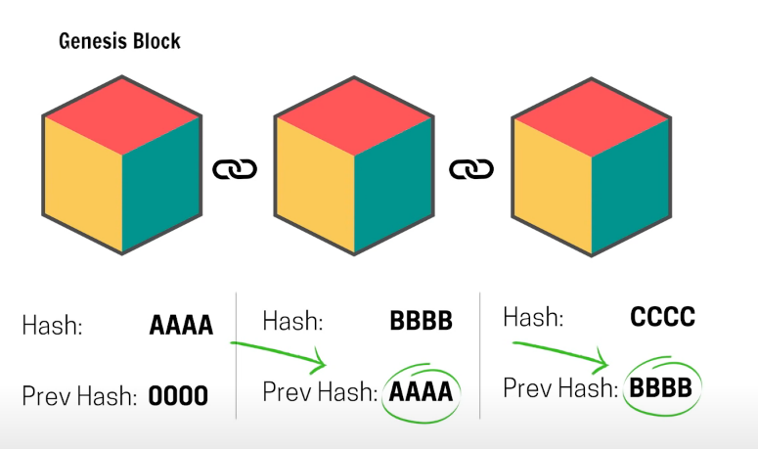

Slide 9
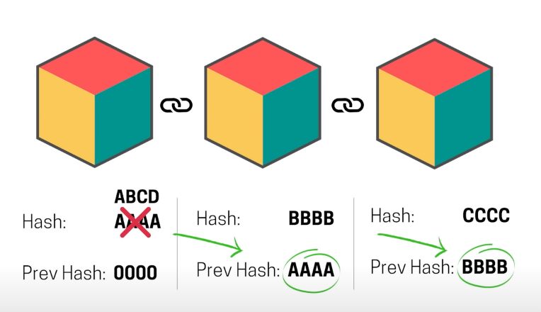

Slide 10
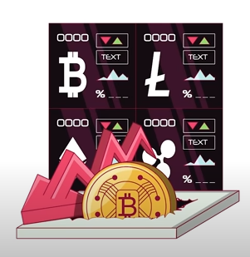
Example
Crypto-currency is a prime example of block chain.
They eliminate the middle banks.
Now they directly send bit-coin to bit-coin by using hash.
That’s why the value of bit-coin increases.

Slide 11

Types of Block Chain
Public block-chains are public, and anyone can join them and validate transactions.

Slide 12

Types of Block Chain
Private block-chains are restricted and usually limited to business networks. A single entity, or consortium, controls membership.

Slide 13

Types of Block Chain
Permission less block-chains have no restrictions on processors.

Slide 14

Types of Block Chain
Permissioned block-chains are limited to a select set of users who are granted identities using certificates.

Slide 15

BlockChain Security

Slide 16

What is the disadvantage of blockchain?
Blockchain technology does not allow easy modification of data once recorded, and it requires rewriting the codes in all of the blocks, which is time-consuming and expensive. The downside of this feature is that it is hard to correct a mistake or make any necessary adjustments

Slide 17

Are all blockchains secure?
Each new block connects to all the blocks before it in a cryptographic chain in such a way that it's nearly impossible to tamper with. All transactions within the blocks are validated and agreed upon by a consensus mechanism, ensuring that each transaction is true and correct.

Slide 18

Why cant blockchain be hacked?
Blockchain technology has many built-in security features that make it difficult for hackers to corrupt. While a cryptocurrency hacker can take over a blockchain, they can likely steal tokens from sources such as a wallet or a cryptocurrency exchange.

Slide 19
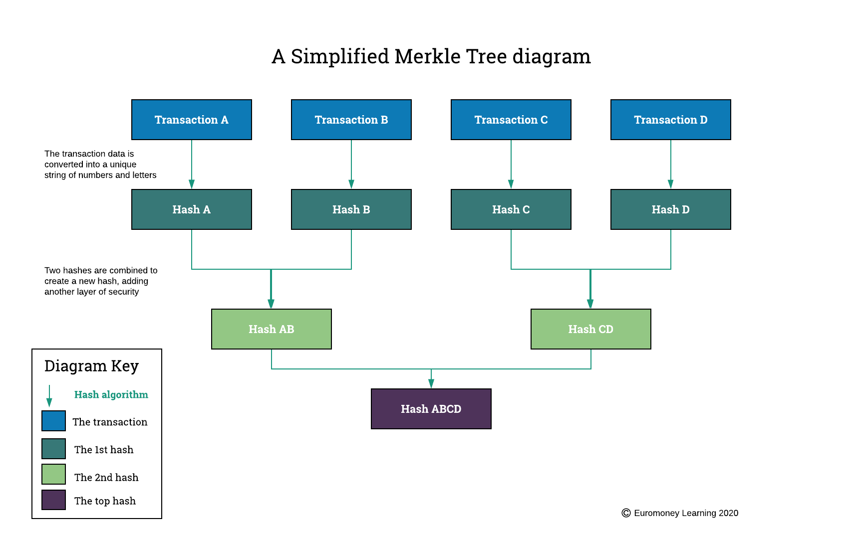

Slide 20

Block Chain security
Blockchain security is a comprehensive risk management system for a blockchain network, using cybersecurity frameworks, assurance services and best practices to reduce risks against attacks and fraud.

Slide 21
How fraudsters attack blockchain technology
Phishing attacks.
Routing attacks.
Sybil attacks.
51% attacks.
Note: Private blockchains are not vulnerable to 51% attacks.

Slide 22

How to Secure
Enforce security controls that are unique to blockchain
Apply conventional security controls
Enforce business controls for blockchain

Slide 23

How blockchain data is secured
The key to keeping blockchain data manageable – and secure – is through an algorithm called hashing in combination with a consolidating data structure known as a Merkle Tree.

